Slide 1
Graduate Students: Project Reminder
Midpoint report due on Monday! Slides for presentations due Sunday.
Schedule time to chat if you are stuck.
Book now!
today 2-3:30, 4:30-5
tomorrow 9-11, 12-2:30
Friday 1-2, 3:30-5
Everyone: include questions about vocab & concepts in your reviews for Friday.

Slide 2
CS 295B/CS 395B Systems for Knowledge Discovery
From Causal Inference to Experimental Design

Slide 3
High level idea for today
Context… but NOT about specific papers
Things that were surprising to me
NOT about vocab
More about framework for reading the papers

Slide 4
Recall…
Collect
Clean
Transform
Discover

Slide 5
Recall…
Snorkle
AutoMan
DeepDive
SurveyMan
Collect
Clean
Transform
Discover
Idea: Read-only
Framing: instruments for measuring phenomena

Slide 6
Now: Experiments
PlanOut
PlanAlyzer
Collect
Clean
Transform
Discover
Idea: Write-read cycle
Framing: instruments for intervention

Slide 7
Experimentation ties together data collection & decision-making much more closely than we’ve seen before

Slide 8
Recall: Research Questions
Previously: implicitly causal questions
Descriptive
What are the characteristics of <phenomena>?
Associative
What is the relationship between…?
Under what conditions…
Causal
Can we <verb> <noun> such that <dependent clause>?
Does X cause Y when Z…?
Now: explicitly causal questions
Notes:
“Under what conditions” leads to the strong association (almost causal) first question → establishing temporal precedent

Slide 9
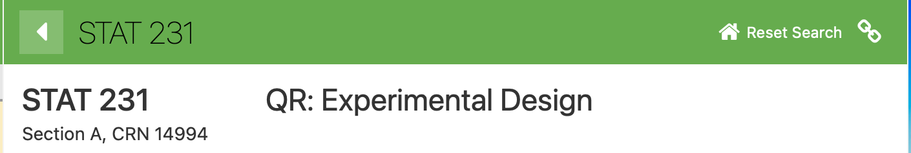
Today’s topics
Recap: Causal inference
Thinking like an experimentalist

Slide 10
Causal Inference → Experimentation

Slide 11
Now: Experiments
PlanOut
PlanAlyzer
CaRL
Collect
Clean
Transform
Discover
Recall: CaRL == declarative language for Causal Relational Learning

Slide 12
Recall: Causal Models
Assuming model structure and parameters are known (completely known mechanism)…
Experiments are just the do-calculus
Fundamental challenge: structure and parameters are unknown
Causal Inference: problem of inferring model structure and parameters from purely observational data
Example do-calculus on board

Slide 13
Pros
Complete model
Can answer any Q!
No need to fetch more data
Experiments purely simulated!
Mechanism is interpretable
Can explain why!
Cons
Rarely known a priori
Can use domain knowledge, but what if you are wrong?
Can be learned from data…up to a certain point
May have incomplete data
Complete model may be complex
Can build a simpler model, but higher variability

Slide 14
Pros
Complete model
Can answer any Q!
No need to fetch more data
Experiments purely simulated!
Mechanism is interpretable
Can explain why!
Cons
Rarely known a priori
Can use domain knowledge, but what if you are wrong?
Can be learned from data…up to a certain point
May have incomplete data
Complete model may be complex
Can build a simpler model, but higher variability

Slide 15
Pros
Complete model
Can answer any Q!
No need to fetch more data
Experiments purely simulated!
Mechanism is interpretable
Can explain why!
Cons
Rarely known a priori
Can use domain knowledge, but what if you are wrong?
Can be learned from data…up to a certain point
May have incomplete data
Complete model may be complex
Can build a simpler model, but higher variability

Slide 16
Pros
Complete model
Can answer any Q!
No need to fetch more data
Experiments purely simulated!
Mechanism is interpretable
Can explain why!
Cons
Rarely known a priori
Can use domain knowledge, but what if you are wrong?
Can be learned from data…up to a certain point
May have incomplete data
Complete model may be complex
Can build a simpler model, but higher variability

Slide 17
Pros
Complete model
Can answer any Q!
No need to fetch more data
Experiments purely simulated!
Mechanism is interpretable
Can explain why!
Cons
Rarely known a priori
Can use domain knowledge, but what if you are wrong?
Can be learned from data…up to a certain point
May have incomplete data
Complete model may be complex
Can build a simpler model, but higher variability

Slide 18
Pros
Complete model
Can answer any Q!
No need to fetch more data
Experiments purely simulated!
Mechanism is interpretable
Can explain why!
Cons
Rarely known a priori
Can use domain knowledge, but what if you are wrong?
Can be learned from data…up to a certain point
May have incomplete data
Complete model may be complex
Can build a simpler model, but higher variability

Slide 19
Pros
Complete model
Can answer any Q!
No need to fetch more data
Experiments purely simulated!
Mechanism is interpretable
Can explain why!
Cons
Rarely known a priori
Can use domain knowledge, but what if you are wrong?
Can be learned from data…up to a certain point
May have incomplete data
Complete model may be complex
Can build a simpler model, but higher variability

Slide 20
Pros
Complete model
Can answer any Q!
No need to fetch more data
Experiments purely simulated!
Mechanism is interpretable
Can explain why!
Cons
Rarely known a priori
Can use domain knowledge, but what if you are wrong?
Can be learned from data…up to a certain point
May have incomplete data
Complete model may be complex
Can build a simpler model, but higher variability

Slide 21
Bivariate case
If all you want is to measure the effect of a
treatment variable on an outcome variable...
…and can set the treatment variable…
Then randomized field experiments are your friend.

Slide 22
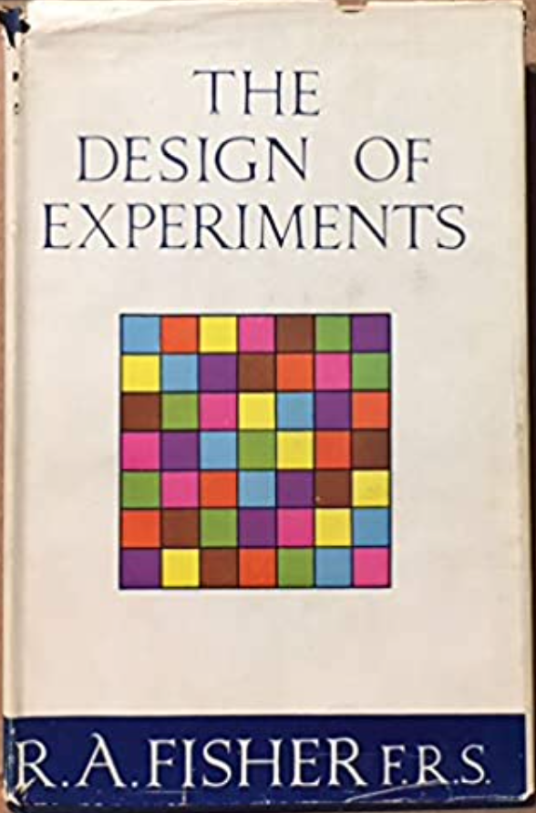

Two big ideas
“Factorial Design”
(vs. OFAT)
Randomized Assignment

Slide 23

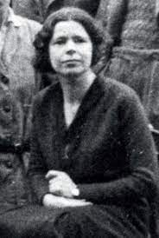
Two big ideas
“Factorial Design”
(vs. OFAT)
Randomized Assignment
(Original was one factor, but let’s be creative)
Muriel Bristol

Slide 24
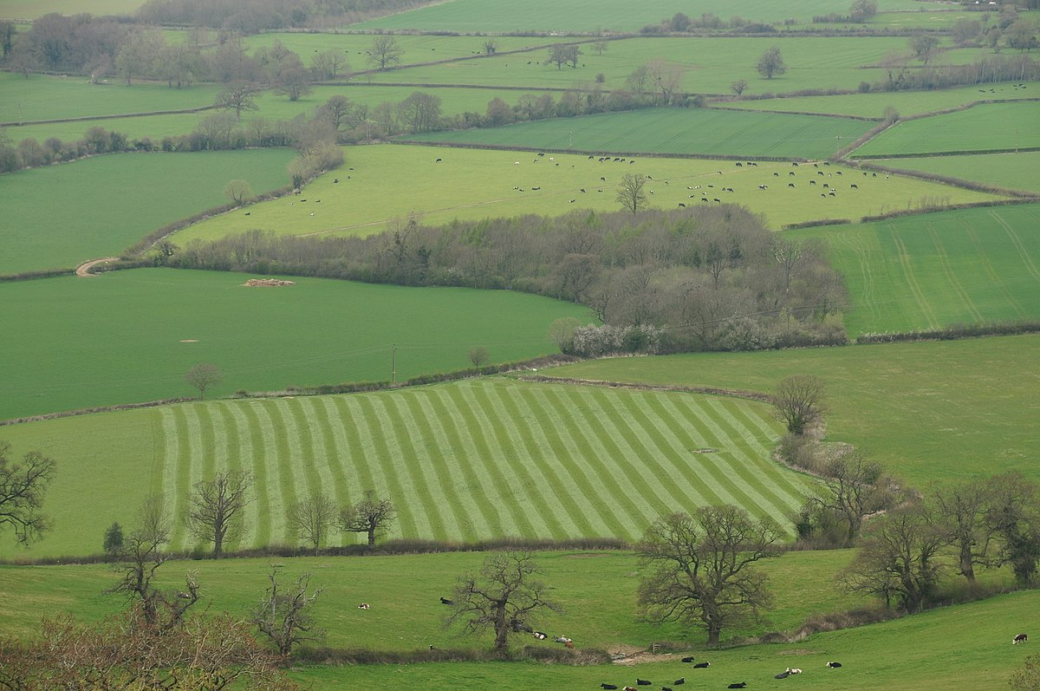
Two big ideas
“Factorial Design”
(vs. OFAT)
Randomized Assignment

Slide 25
Two big ideas
“Factorial Design”
(vs. OFAT)
Randomized Assignment
Both experiments have replicates

Slide 26
Thinking like an experimentalist

Slide 27
Shift in how we think about platforms
AMT
Participant knows, deception is hard
Close to laboratory experiment
Purely discretionary
Facebook
Participant may not know
Field experiment
May be necessary

Slide 28
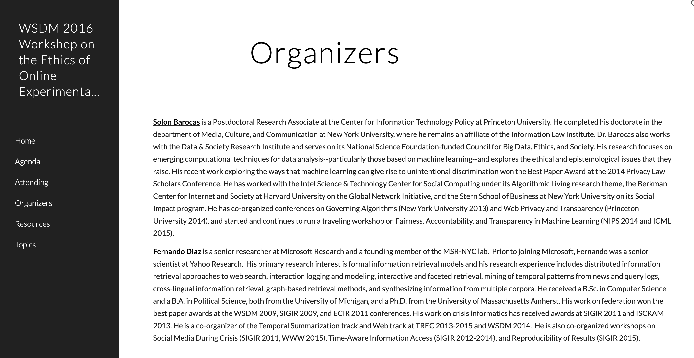
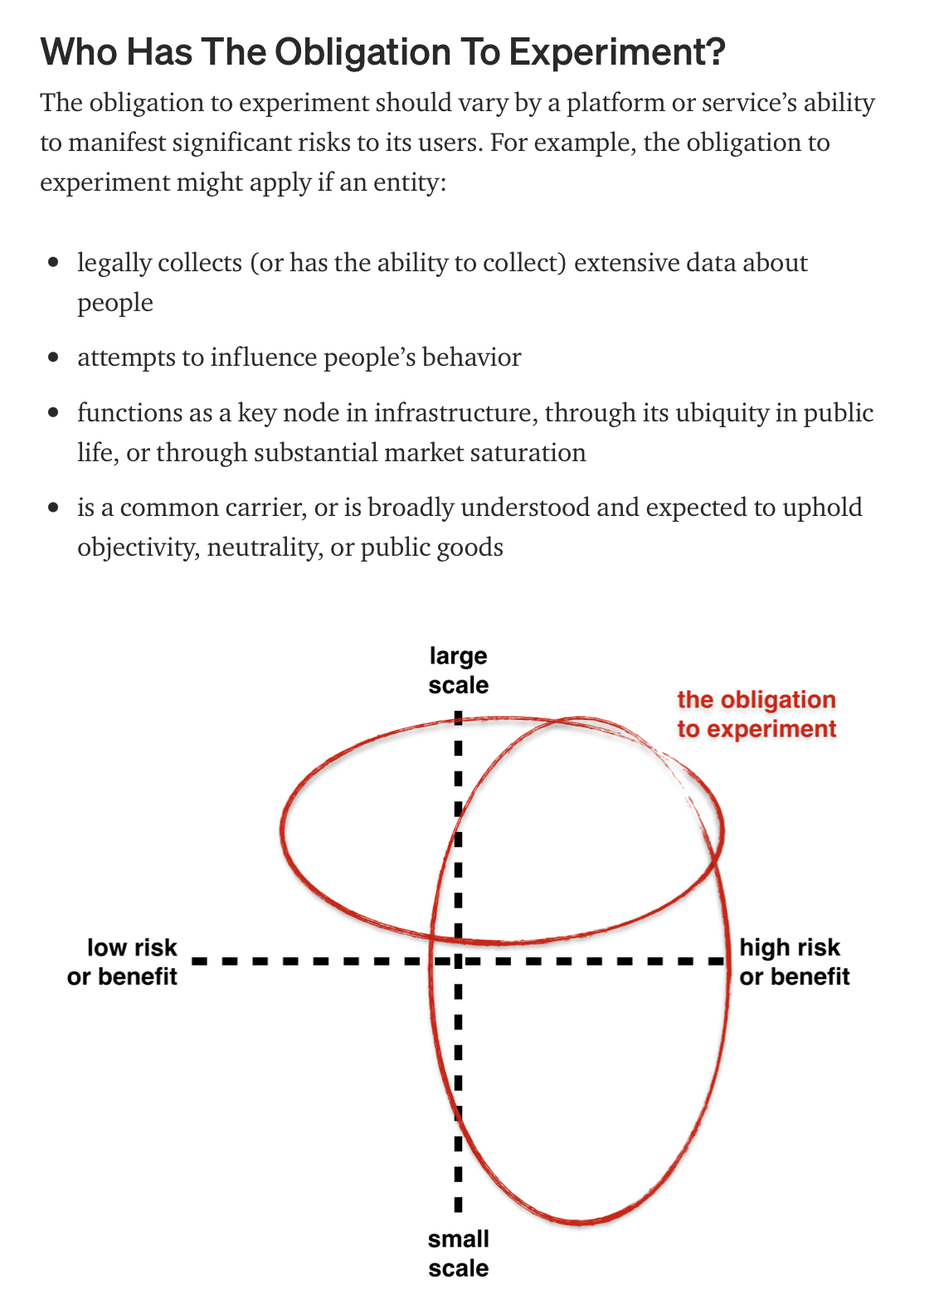
Fernando Diaz: When is it okay to experiment?
Allan Ko, Merry Mou, J. Nathan Matias

Slide 29
Scientific Method
Ask a question
Science is a subset of knowledge
Scientific method under-formalized
Construct a (falsifiable) hypothesis
Formalization:
Explicit rules
(usu. mathematical notation, bounded ambiguity)
Test hypothesis (experiment)
Analyze results
Report
Draw diagram of RQs on board

Slide 30
Scientific Method
Ask a question
Science is a subset of knowledge
Scientific method under-formalized
Construct a (falsifiable) hypothesis
Test hypothesis (experiment)
Questions & Reports don’t need formalization
(About communication)
Are hypotheses under-formalized?
No: hypotheses are candidate causal models
(can be expressed as CGMs)
Analyze results
Report
Draw diagram of RQs on board

Slide 31
Scientific Method
Ask a question
Science is a subset of knowledge
Scientific method under-formalized
Construct a (falsifiable) hypothesis
Test hypothesis (experiment)
Are hypotheses under-formalized?
No: hypotheses are candidate causal models
(can be expressed as CGMs)
Analyze results
Report
Draw diagram of RQs on board

Slide 32
Scientific Method
Ask a question
Science is a subset of knowledge
Scientific method under-formalized
Construct a (falsifiable) hypothesis
Test hypothesis (experiment)
Are experiments under-formalized?
Yes! (often treated as a black box)
Variability based on context
Operationalization not yet generalized
Analyze results
Report
Draw diagram of RQs on board

Slide 33
Scientific Method
Ask a question
Science is a subset of knowledge
Scientific method under-formalized
Construct a (falsifiable) hypothesis
Test hypothesis (experiment)
Are analyses under-formalized?
Yes…ish…
See: work on formal methods for statistical software
Key problems: assumptions, definitions of correctness
Analyze results
Report
Draw diagram of RQs on board

Slide 34
Scientific Method
Ask a question
Science is a subset of knowledge
Scientific method under-formalized
Diagram not always true to practice
Construct a (falsifiable) hypothesis
Test hypothesis (experiment)
Analyze results
Report
Draw diagram of RQs on board

Slide 35
Scientific Method
Ask a question
Science is a subset of knowledge
Scientific method under-formalized
Diagram not always true to practice
Construct a (falsifiable) hypothesis
Test hypothesis (experiment)
Not just about negative results!
Analyze results
Report
Draw diagram of RQs on board

Slide 36
Scientific Method
Ask a question
Science is a subset of knowledge
Scientific method under-formalized
Diagram not always true to practice
Construct a (falsifiable) hypothesis
Test hypothesis (experiment)
Byproduct of limitations of software systems
Analyze results
Report
Draw diagram of RQs on board

Slide 37
Necessity is the mother of invention
Ask a question
Typical: limited interventions
Construct a (falsifiable) hypothesis
Test hypothesis (experiment)
Analyze results
Report
Draw diagram of RQs on board

Slide 38
Necessity is the mother of invention
Test hypothesis (experiment)
Typical: limited interventions
Ask a question
Construct a (falsifiable) hypothesis
Analyze results
Report
Draw diagram of RQs on board

Slide 39
Necessity is the mother of invention
Design intervention
Typical: limited interventions
Typical: limited measurable outcomes
Ask a question
Construct a (falsifiable) hypothesis
Analyze results
Report
Draw diagram of RQs on board

Slide 40
Necessity is the mother of invention
Design intervention
Typical: limited interventions
Typical: limited measurable outcomes
Analyze results
Ask a question
Construct a (falsifiable) hypothesis
Report
Draw diagram of RQs on board

Slide 41
Necessity is the mother of invention
Design intervention
Typical: limited interventions
Typical: limited measurable outcomes
Hypothesis falls out of intervention/outcome
Define measurable outcome
Ask a question
Hypothesis model always shallow
Construct a (falsifiable) hypothesis
Report
Draw diagram of RQs on board

Slide 42
Necessity is the mother of invention
Design intervention
Typical: limited interventions
Typical: limited measurable outcomes
Hypothesis falls out of intervention/outcome
Instead: bundle experiment + logging as data collection
Define measurable outcome
Ask a question
Construct a (falsifiable) hypothesis
Report
Draw diagram of RQs on board

Slide 43
Necessity is the mother of invention
Design intervention
Typical: limited interventions
Typical: limited measurable outcomes
Hypothesis falls out of intervention/outcome
Instead: bundle experiment + logging as data collection
Define measurable outcome
Ask a question
Deploy & collect data
Report
Draw diagram of RQs on board

Slide 44
Necessity is the mother of invention
Design intervention
Typical: limited interventions
Typical: limited measurable outcomes
Hypothesis falls out of intervention/outcome
Instead: bundle experiment + logging as data collection
Define measurable outcome
Deploy & collect data
Ask a question
Report
Draw diagram of RQs on board

Slide 45
Necessity is the mother of invention
Design intervention
Typical: limited interventions
Typical: limited measurable outcomes
Hypothesis falls out of intervention/outcome
Instead: bundle experiment + logging as data collection
Bundled reports & RQs, add back analysis
Define measurable outcome
Deploy & collect data
Ask a question
Report
Draw diagram of RQs on board

Slide 46
Necessity is the mother of invention
Design intervention
Typical: limited interventions
Typical: limited measurable outcomes
Hypothesis falls out of intervention/outcome
Instead: bundle experiment + logging as data collection
Bundled reports & RQs, add back analysis
Define measurable outcome
Deploy & collect data
Report on RQs
Draw diagram of RQs on board

Slide 47
Necessity is the mother of invention
Design intervention
Typical: limited interventions
Typical: limited measurable outcomes
Hypothesis falls out of intervention/outcome
Instead: bundle experiment + logging as data collection
Bundled reports & RQs, add back analysis
Define measurable outcome
Deploy & collect data
Analyze results
Report on RQs
Draw diagram of RQs on board

Slide 48
Necessity is the mother of invention
Design intervention
Typical: limited interventions
Typical: limited measurable outcomes
Hypothesis falls out of intervention/outcome
Instead: bundle experiment + logging as data collection
Bundled reports & RQs, add back analysis
Define measurable outcome
Deploy & collect data
Analyze results
Report on RQs
Draw diagram of RQs on board

Slide 49
Discussion: Computer experiments vs. field experiments Where does variability come from?

